Slide 1
Angular Upskilling Program
Forms Module
Reactive Forms

Slide 2
Reactive Forms
Reactive Forms provides a reactive approach for handling input changes: every form control is an observable stream.
It provides immutability out of the box and guarantees that every time a change has been done, a new instance of the model will be created.
Transferred the form logic from the template directly to the component
Template driven forms are updating data asynchronously while on reactive form the data is updated synchronously.

Slide 3
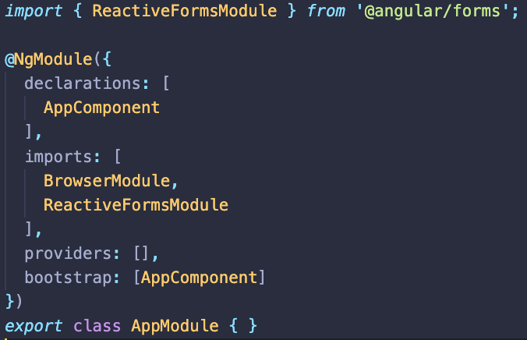
How to use - FormControl
Import ReactiveFormsModule from @angular/forms
Declare a FormControl object in the component;
Data binding between input value and component is done by using FormControlDirective

Slide 4
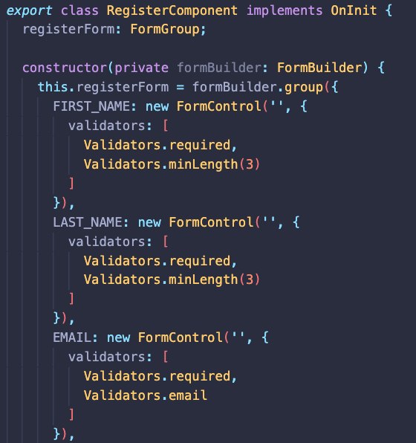
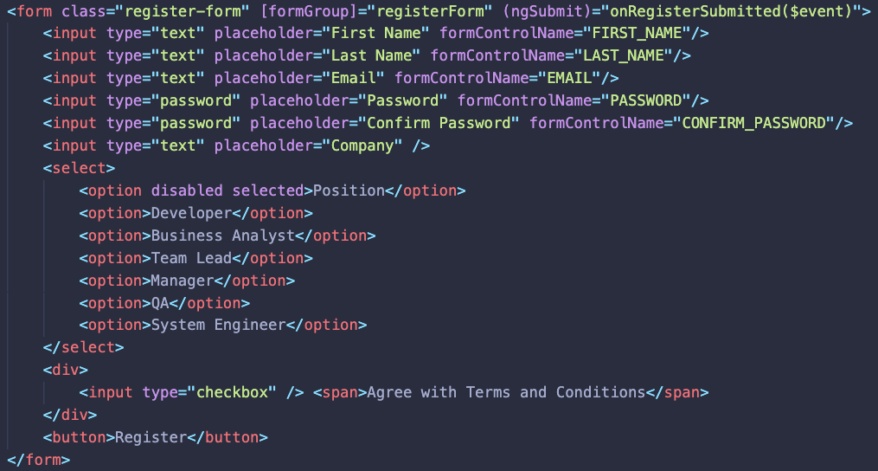
How to use – FormGroup
When working with more than one input field, it’s better to group all FormControls into a single property of type FormGroup:
1. Create a property of type FormGroup;
2. Instantiate it by using the new keyword or FormBuilder service;
3. Bind the value from template to each FormControl;

Slide 5
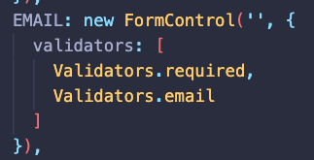
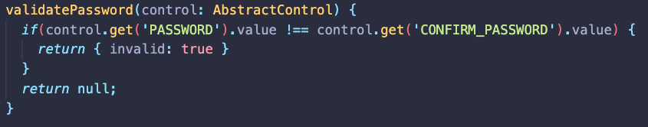
Validators
Reactive forms are using the same validators as template driven forms with the validation logic moved to the component instead of template.
If for template driven forms we needed custom directives for creating validators, for reactive forms only simple functions are needed.

Slide 6
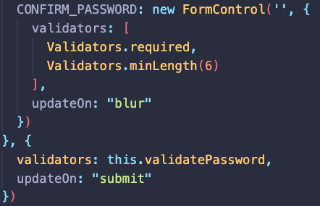
UpdateOn
One known problem of Angular applications is related to the ChangeDetection mechanism and how it can impact the performance if too many fields are updating at once.
ReactiveFromsModule gives the possibility to manipulate the behavior of how the individual FormControls should update or even the form itself.
There are 3 states that can be used to control this behavior:
change (default) – The form and the control is updated whenever a change has been done;
blur – The form and the control is updated whenever the focus is lost on the elements;
submit – The form and the control is updated only after the submit button is hit;

Slide 7

Submitting
For handling the submission of an angular form that is using either template driven forms or reactive forms a special event called ngSubmit should be handled;
Usually, whenever a button from the form is pressed the ngSubmit event handler will be triggered;
In order to avoid that we will have to explicitly specify the type of the button that we are declaring:
Type “submit” for the button that is triggering the ngSubmit event;
Type “button” for any other button that is added to the form;

Slide 8


